Slide 1
Arm Education
2018 Update

Slide 2
Arm Education
Addressing the Education/Skills Gap
Arm University Program
Arm Education Media
Arm School Program
Support academia and the wider engineering community with premium educational content incl. interactive online courses and text/books
Help academics and students access state of the art technologies from the Arm ecosystem to plug the education and skills gap
Subsidies the wider education effort
Free offerings to academia
Help address the growing education/skills gap between the needs of the modern economy/society and school teaching curricula
Encourage school students to appreciate, consider and/or pursue successful STEM careers

Slide 3
Arm Education Media

Slide 4
Why Arm Education Media Exists
Success of Arm AUP Program
Academics Need to Address Challenges
Growth since 2013
AUP is one of the biggest university program in the semiconductor industry (1,000+ universities worldwide)
Limited time and teaching resources to educate students
Need to transition students from undergraduates to highly-sought after researchers
Must produce a highly-motivated workforce equipped with essential skills
Fix engineering skills gap and worker shortages that exist in engineering today
Enabling access to accelerated learning technologies to handle social shifts anticipated by artificial intelligence and automation

Slide 5

Arm Education Media’s Online Courses
Lecture videos
Split thematically
Lab videos
Split thematically
Interactive quizzes
Multiple choice questions and problems with answers
Multi-platform with a 4-year upgrade cycle
Always state-of-the-art, wide choice
Notes:
Driven by demand from academia, we created ARM Education Media, a digital-first publishing operation, to produce and market premium educational products:
Online courses: self-taught courseware in the form of lecture and lab demonstrator videos, interactive quizzes with answers, project codes with solutions
E-textbooks with Print-On-Demand (POD) option
AUP:
Intermediated Education Kit content (lecture slides, lab manuals, code etc.) - donated to university professors
AEM:
Self-taught and self-paced online Education Kits, multimedia rich and highly interactive – for purchase by everyone

Slide 6
Current AEM Online Course Product Roadmap
Electronic System Design and Programming
IoT
Graphics/Gaming
Broad Academic Topics
Computer Architecture
First Upgrade Beat Year
Efficient Embedded
RT Operating Systems
Embedded System Design and Programming
Rapid Embedded
Alpha Version
Full Version
Linux Kernel Development
DSP
Intro. to SoC Design
Released
VLSI Design and Computer Architecture
Development
Adv Planning
Advanced SoC Design
Mechatronics/Robotics
Concept
VLSI Design
2016
2017
2018
2019
2020
Roadmap version – Jan 2018
Timeline for online course availability

Slide 7
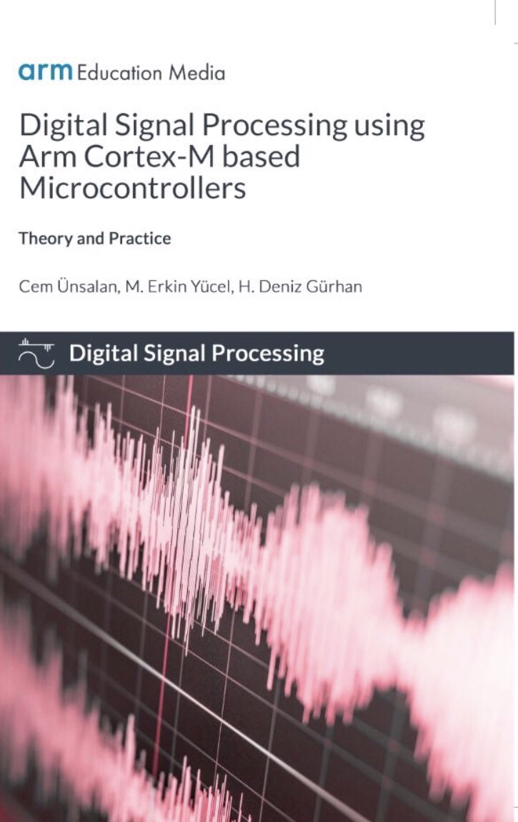
E-First Textbooks (Products)
Complements online courses with wider coverage of topics
Digital-First with Print-on-Demand
First e-textbook
Embedded Systems Fundamentals with ARM Cortex-M based Microcontrollers:
A Practical Approach
by Dr Alexander G. Dean
ISBN 978-1-911531-03-6
Coming Soon
Digital Signal Processing using Arm Cortex-M based Microcontrollers: Theory and Practice
December 2018 Publication Date
Notes:
Combine theory and practice

Slide 8
Current AEM Textbook Product Roadmap
Electronic System Design and Programming
Rapid Embedded
Mechatronics/Robotics
Graphics/Gaming
First Upgrade Beat Year
Broad Academic Topics
Efficient Embedded
RT Operating Systems
Linux Kernel Development
Embedded System Design and Programming
LAC (ES)
EAC
(RP)
IoT
DSP
Intro. to SoC Design
Released
Computer Architecture
VLSI Design and Computer Architecture
Development
Advanced SoC Design
Adv Planning
Concept
VLSI Design
2017
2018
2019
2020
2021
2022
Timeline for EK Textbook Availability/Development
Roadmap version – Jan. 2018

Slide 9
Learner Benefits
Saves Time for Academics and Students | Lots of Quality Resources
Self-taught highly interactive materials that allow learners to go at their own pace Saves academics maintenance and quality assurance time by allowing them to focus on pedagogy Increases student satisfaction by giving students access to industry-relevant materials whenever and wherever they want | Extensive course offerings covering computer engineering, computer science, electrical and electronic engineering degree Materials are academically rigorous and industry-relevant The four-year update cycle ensures content remains state-of-the-art Courses use similar underlying technologies for hardware and software
Extensive Arm Ecosystem | Prepares Students for Today’s Technology Needs / Increases Satisfaction
125 billion Arm-based chips 1,100+ partners Arm technology reaches 80% of global population | Help learners develop more skills and become work-ready Easy to access resources online or to integrate to subscriber’s Learning Environment

Slide 10

Check Out Arm Education Media
Contact
Individuals
Company Website: http://www.armedumedia.com
Academic Institutions and Corporations
Email: edumedia@arm.com
Online media and textbooks
Easy to find and purchase
Multi user and site license pricing available
Subscription and purchase options available

Slide 11
How to Collaborate with Arm Education Media
Do your part in shaping today’s educational system. Work with Arm Education Media to help create or review Arm academic textbooks and online courses.
Roles for You
Topics Covered
Author
Content creator
Internal and external review
IoT
Rapid Embedded Systems
RTOS
Mechatronics
Graphics and Mobile Gaming
VLSI
SoC Design
Computer Architecture

Slide 12
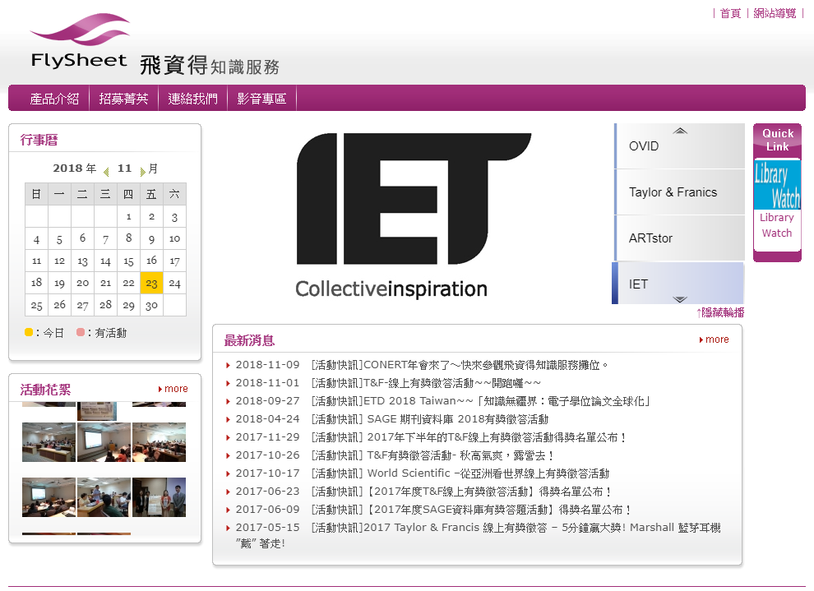


徐淑娟 Kris Hsu
krishsu@flysheet.com.tw
02657-5996 ext.535
# 課程訊息 #試用 #報價 #客戶服務
http://econtent.flysheet.com.tw/

